Slide 1
Programming Requirements
Last updated Jan 30, 2015, 8:00PM

Slide 2
Drive Subsystem Requirements (last updated Jan 30, 2015)
Subsystem Name: Drive
Purpose: Drive Mecanum Chassis based on speed and directional inputs
Team:
Scott G, Robin O
Inputs:
Sensors:
Accelerometer
Gyro
Teleop and Auton:
intended speed
intended turn
intended distance (in Auton
mode)
Functional Requirements:
Teleop control
Drive based on 3 inputs of x speed (leftXAxis), y speed (leftYAxis), and turn (rightXAxis)
Enable mode for gyro guidance (field oriented driving, so for ex. joystick forward always move forward on field even when robot turned)
Auton control
Drive a given distance at a given speed and direction (requires gyro and accelerometer feedback)
Turn a given angle at a given rotational speed (requires gyro feedback)
Handle accurate distance travel even if navigating ramp (anticipated that auton mode will have calibrations to make correction)
Outputs:
Motors and Actuators:
Drive Motors (4 Victors)
SmartDashboard:
Gyro readings
Accelerometer readings
Battery voltage
Failure Conditions:
None
Testing Notes:
Initial tests: use existing CAN motor test chassis with gyro, until team can build with Victor motor controllers
After chassis converted: run test for each functional requirement and failure condition.
Additionally run multiple iterations of tests to determine variance associated with automated features to
Drive a given distance at a given speed, including ramp
Turn a given angle at a given rotational speed

Slide 3
Interior Tote Feed Subsystem Requirements (last updated Jan 30, 2015)
Subsystem Name: InteriorToteFeed
Purpose: Drive two Tote Feeder wheels to rotate or feed totes, and wheel clamping mechanism
Team:
Debjit S., Matt S., Mahir T.
Inputs:
Photosensor input indicating
tote loaded (or other sensor?)
PowerDistributionPanel motor
current draws (for failure mode)
Teleop and Auton:
left wheel speed and dir
right wheel speed and dir
clamp/unclamp command
Functional Requirements:
Drive motors based on motor speed inputs
Output tote loaded/unloaded state to SmartDash (or maybe even robot LEDs to make it easier on driver, or can we shake secondary joystick?)
Clamp/unclamp tote when commanded
Outputs:
Feeder Motors (2)
Clamp Solenoid (dual)
SmartDashboard:
Tote loaded indicator
Current failure indicator
Failure Conditions:
If either motor current exceeds (TBD) amps for 250 msec
Set motor speeds to 0
Output to dashboard motor failure occurred (maybe robot LEDs
Stay in failure state until external command received setting
motor speed back to 0 (ex. indicating driver stopped motor)
Exit failure mode
Update dashboard
Testing Notes:
Before robot built: can use any Victor to test, including failure conditions
After robot built – run tests to
Feed totes
Turn totes on field
Run tests to identify optimal motor speed to feed totes
Run tests to identify optimal motor speed to turn totes
Test failure condition of motor jammed and high current draw (test both motors)

Slide 4
Interior Lift Subsystem Requirements (last updated Jan 30, 2015)
Subsystem Name: InteriorLift
Purpose: Lift totes so they can be stacked, and release totes on command
Team:
Debjit S., Matt S., Mahir T.
Inputs:
Lift encoder (to measure up/down travel)
Limit switches to indicate top and
bottom of lift travel (2)
Teleop and Auton:
lift up command (1 level)
lift down command (1 level)
lift manual up/down (speed)
clamp/unclamp command
ratchet unrelease/release
command
Functional Requirements:
Initialize lift encoder at bottom
Clamp/unclamp when commanded
Lift clamps one level when commanded
Lower clamps one level when commanded
Allow manual move up/down of clamps
Prevent driver from moving down while clamped and ratchet locked?
Outputs:
Clamp solenoid (single)
Lift motor
Tote release solenoid (single)
SmartDashboard:
Position of lift
Current failure indicator
Failure Conditions:
If lift motor current exceeds (TBD) amps for 250 msec
Set motor speeds to 0
Output to dashboard motor failure occurred (maybe robot LEDs
Stay in failure state until external command received setting motor speed back
to 0 (ex. lift button not pushed and no manual lift/drop)
Exit failure mode
Update dashboard
Limit switches hit, don’t allow travel in same direction
Testing Notes:
Before robot built: need motor with dual encoder on RoboRIO to test. Do we also need additional solenoid? Or since we have 2 single acting solenoids maybe not?
After robot built
Run tests to lift totes one level with 1 tote, 2 totes…
Determine reasonable speed for lifting
Determine encoder values to match distance traveled to move 1 level
Run tests to release totes, also with 1 tote, 2 totes, …
Test failure condition of motor jammed and high current draw
Test failure condition of limit switches hit

Slide 5
Exterior Subsystem Requirements (last updated Jan 30, 2015, 8:00PM)
Subsystem Name: Exterior
Purpose: Clamp and lift totes or containers via exterior mechanism, including tilting to pick up tipped over containers.
Team:
Simon S., Eric K.
Inputs:
Dual encoder to measure
up/down travel
Limit switches to indicate top and
bottom of travel (2)
Teleop and Auton
manual up/down (speed)
clamp/unclamp command
angle up/angle down command
Functional Requirements:
Initialize encoder value at bottom mechanical stop
Clamp/unclamp when commanded
Move up/down when commanded
Any time when up/down motor command to move, disable brake, otherwise enable brake
Change angle up/down when commanded
Any time angle up/down is commanded to move, disable brake, otherwise enable brake
Outputs:
Clamp solenoid (dual)
Lift motor
Lift brake solenoid (single)
Angle motor
Angle brake solenoid (single)
SmartDashboard:
Position of exterior assembly
(up/down)
Failure Conditions:
Limit switches hit, don’t allow travel in same direction
Testing Notes:
Before robot built: need solenoid and motor with dual encoder on RoboRIO to test.
After robot built
Run tests for each functional requirement
Run tests to lift upright totes and bins to calibrate more speeds
Run tests to calibrate angle speeds
Test failure condition of limit switches hit

Slide 6
Auton Subsystem Requirements (last updated Jan 30, 2015)
Subsystem Name: Auton
Purpose: Automatically control robot for first 15 seconds of match based on preconfigured auton modes
Team:
Roi S., Sonya S., Alex C.
Inputs:
3 switch control box to specify
auton mode (8 states)
Calls to other subsystems for inputs:
Drive
ToteFeed
Interior
Exterior
Functional Requirements:
See Strategy Team slide for Auton modes “Recycle_Rush_Auton_Game_Strategy_Picture”
Outputs:
Calls to other subsystems for outputs:
Drive
ToteFeed
Interior
Exterior
Failure Conditions:
No additional failure conditions (delegated to subsystems)
Testing Notes:
Before robot built: Ensure basic auton programming architecture and functions working (will be difficult to get any calibration, but ensure basic logic/control working
After robot built
Run tests for each auton mode
Significant tuning/calibration required (timing, motor speeds)

Slide 7
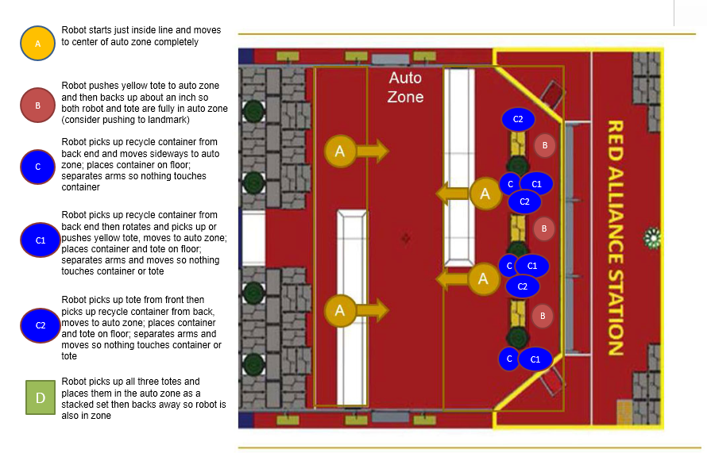
Auton Subsystem Requirements (last updated Jan 30, 2015) copied from Strategy Team: Recycle_Rush_Auton_Game_Strategy_Picture.pptx NOTE: when reviewed with Roi 1/28 he suggested auton B may have different starting point, need to get feedback to Strategy Team

Slide 8
Teleop Subsystem Requirements (last updated Jan 30, 2015)
Subsystem Name: Teleop
Purpose: Provide functions for driver control of robot
Team:
Miles M., Prateek P.
Inputs:
Game controllers
Optional: keyboard input?
Functional Requirements:
Provide capability for 2 drivers to control all robot functions required for Teleop period
See next slide for list of items to control, and controls diagram TBD
Outputs:
Calls to other subsystems for outputs:
Drive
ToteFeed
Interior
Exterior
Failure Conditions:
No additional failure conditions (delegated to subsystems)
Testing Notes:
Test every game controller button, joystick, and dial to confirm each motor and actuator can be controlled as expected
Experienced drivers test robot to provide feedback re: sensitivity of controls and ease of use

Slide 9
Teleop Subsystem Requirements: Output List (last updated Jan 30, 2015 8:00PM)
Drive Subsystem:
linear direction and speed: Joystick
rototation angle and speed: Joystick
(could be a “pilot” controller with twist,
may want to try this)
Field oriented driving (gyro) enabled: toggle
InteriorLift Subsystem:
lift up command (1 level)
lift down command (1 level)
lift manual up/down (speed)
clamp/unclamp command
ratchet unrelease/release
command
Exterior Subsystem:
Clamp/unclamp: toggle
Lift up/down: Joystick or 2 push buttons?
Angle up/down: Joysticks or 2 push buttons?
InteriorToteFeed Subsystem:
Clamp/unclamp: toggle
feed/manipulate item left/right: Joystick? Or
use 3 push buttons?

Slide 10
Teleop Subsystem Requirements: Diagram (last updated Jan 30, 2015)
Diagram of game controllers with annotations showing purpose of each button, joystick, etc.
Owner of these requirements is the drive team – for starters can start with blank picture of game
Controllers and previous slide listing outputs and map these outputs to the controls

Slide 11
Display Requirements (SmartDash) (last updated Jan 30, 2015)
Drive Subsystem:
camera output
gyro reading
battery reading (green if ok,
bright red if low)
Obtain requirements for SmartDash layout from Drive Team, prototype and snapshot into this box where display elements will appear, size, etc.
May want to put all the fa
ToteFeed Subsystem:
Tote loaded indicator
Motor current failure indicator
Interior Subsystem:
Position of lift
Tote loaded indicator
Current failure indicator
Limit switch enabled (2)
Exterior Subsystem:
Position of exterior assembly
Limit switch enabled (2)

Slide 12
To-do: vision – which subsytem? calibrations – add to each slide logging (there’s nothing worse than having failure at match and having nothing to look at)

