Slide 1
2015 FIRST Competition
Game Overview The Arena
Match Format Game Play
Definitions Robot
Safety Considerations
Scoring Key Date
Fouls Discussion

Slide 2
Game Overview
Recycle Rush is a recycling-themed game.
Two 3-team alliances compete simultaneously in each MATCH.
Points scored by stacking Totes on Scoring Platforms, capping those stacks with Recycling containers, and properly disposing of Litter.
In keeping with theme, all scoring elements are reusable or recyclable at end of season.
Object is to score as much as possible during a 2 minutes and 30 second match.

Slide 3
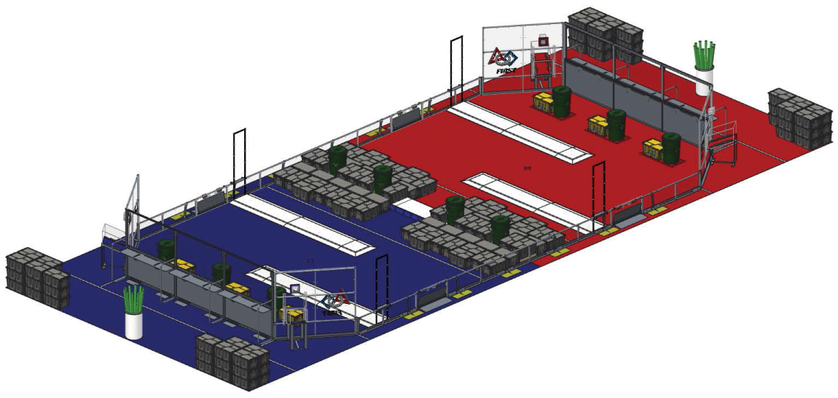
Game Overview
Game played on a flat 27 X 54 foot carpeted field.
Field bisected by a small Step which may not be climbed on or crossed by Robots.
Each alliance competes on their respective 26 x 27 foot area.

Slide 4
Game Overview
Tournament Format
Practice Matches
To practice or run your robot on the field prior to qualification matches
Qualification Matches
Earn seeding position that may qualify you for Elimination Matches
Playoff Matches (No longer called Elimination Matches)
Determine the Champions

Slide 5
Game Overview
Qualification Average
Each Team receives MATCH points equal to their Alliance’s final score (unless a surrogate, disqualified, or no-show happens).
The total number of Match points earned by a Team for all Qualification matches is divided by their number of assigned matches, then truncated to two decimal points for their Qualification Average.
2 Points for Win
1 Point for Tie
0 Points for Loss

Slide 6
Seeding
All teams seeded during qualification matches.
Teams ranked in this order:
Order | Points
1 | Qualification score
2 | Cumulative sum of Coopertition Points
3 | Cumulative sum of auto points
4 | Cumulative sum of scored Recycling Container points
5 | Cumulative sum of scored Tote points
6 | Cumulative sum of scored Litter points (Litter in a scored Recycling container + Litter scored in the Alliance’s landfill zone + Unprocessed Letter Bonus)
6 | Random sorting by FMS

Slide 7
Playoff Matches
Playoff Advancement
Eight (8) Alliances will play two matches each during the quarterfinals (using defined schedule).
The top four Alliances advance to the Semi-Finals where they each play three more matches.
The top two Semi-Final Alliances advance to the Finals where the winning Alliance is determined.

Slide 8
Playoff Matches
Quarterfinals and Semi-Finals
Uses same process as Qualification Average but only for either the two matches in the quarterfinals or the three matches in the semi-finals.
Order | Points
1 | Playoff score
2 | Cumulative sum of auto points
3 | Cumulative sum of scored Recycling Container points
4 | Cumulative sum of scored Tote points
5 | Cumulative sum of scored Litter points (Litter in a scored Recycling container + Litter scored in the Alliance’s landfill zone + Unprocessed Letter Bonus)

Slide 9
Playoff Matches
Finals
In the Finals matches, teams do not earn match points; they earn a Win, Loss or Tie.
The first alliance to win two matches is the Champion.

Slide 10
Definitions
Alliance: Set of up to four FRC teams who play Recycle Rush together.
Coopertition Set (20 Points):
Teleop scoring option benefiting both Alliances
At least four yellow totes fully supported by the Step,
And not a Coopertition Stack
Coopertition Stack (40 Points):
similar to Set but the yellow totes are stacked in a single column fully supported by the step
and stays free of contact from robots for at least three seconds

Slide 11
Definitions
Team positions:
COACH: Student or adult mentor designated as the team coach and advisor during the match (1)
DRIVER: Pre-college student (2)
HUMAN PLAYER: Pre-college student responsible for entering game elements into playing field

Slide 12
Safety
Robots whose operation or design is dangerous or unsafe are not permitted.
Other safety rules are in the manual.

Slide 13
Scoring – Complicated but simple
Auto Point Values
Action | Value
Robot Set | 4
Tote Set | 6
Container Set | 8
Stacked Tote Set | 20
Teleop Point Values
Action | Value
Scored Gray Tote | 2 per tote
Scored Recycling Container | 4 per level
Litter Scored in/on Recycling Container | 6 per Recycling Container
Litter Scored in Landfill Zone | 1 per Litter
Unprocessed Litter Bonus | 4 per Litter
Coopertition Set (Qualification Only) | 20 for each Alliance
Coopertition Stack (Qualification Only) | 40 for each Alliance

Slide 14
The Arena

Slide 15
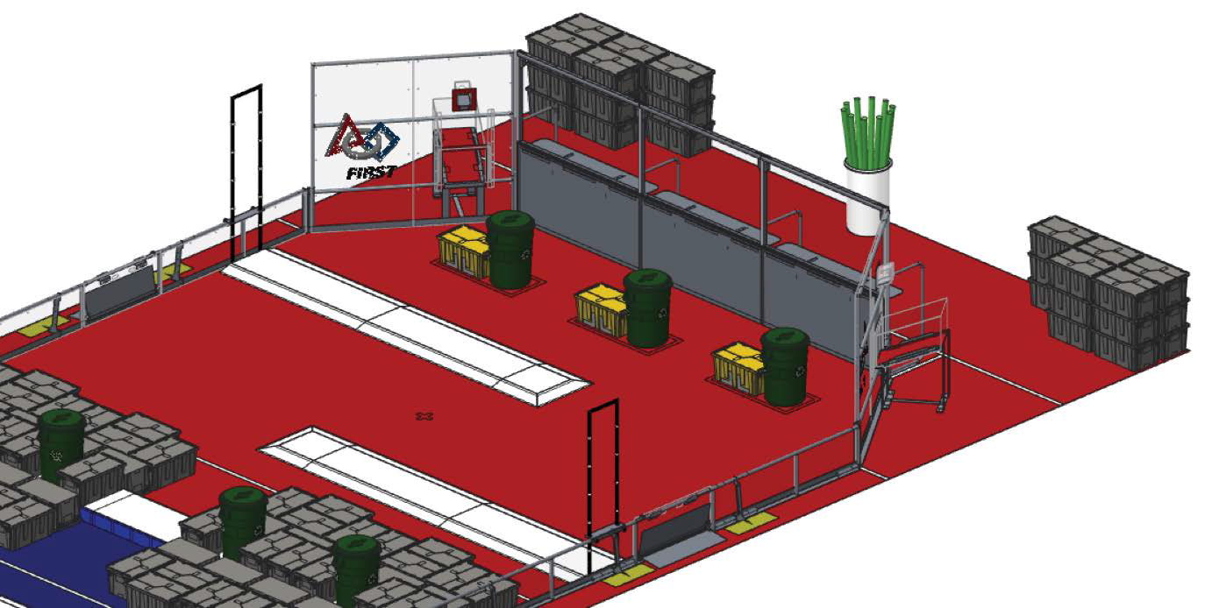
Alliance Zone
Alliance Wall
Scoring Platforms
Step
Backstop
Landmark

Slide 16
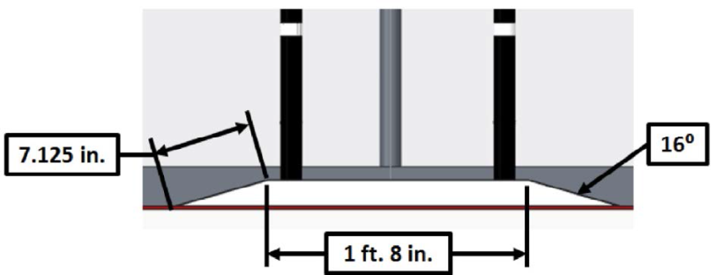
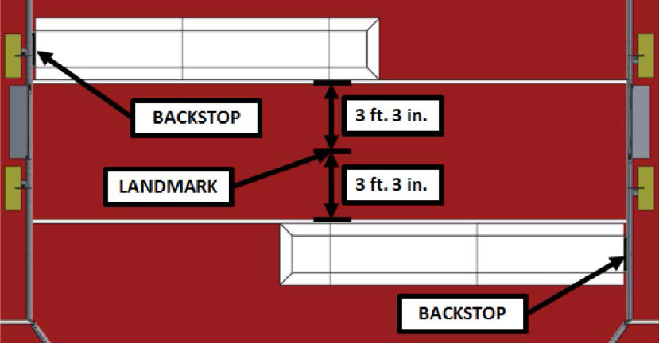
Scoring Platforms

Slide 17
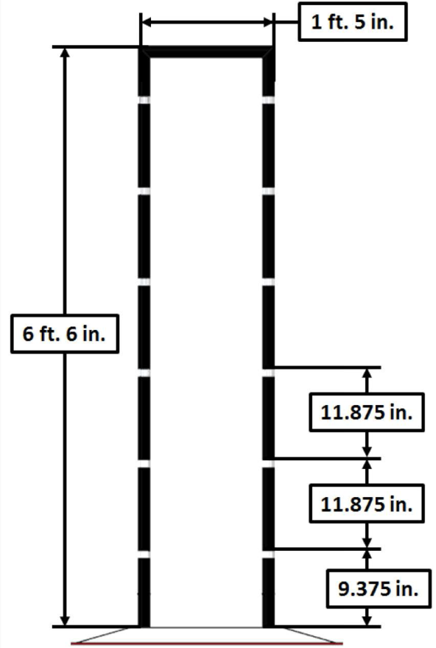
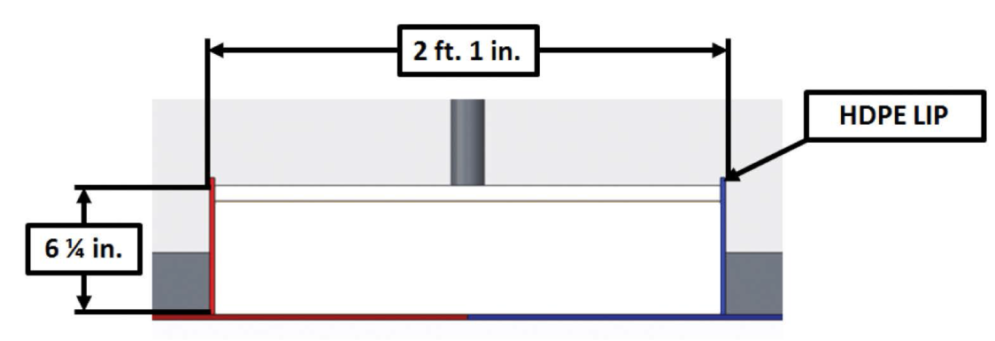
Backstop and Step
Step is a wooden platform that bisects the Field.
Lip helps prevent Totes from being pushed off the Step too easily.
Backstop meant to prevent Totes and Recycling Containers from falling outside of field.
Graduated markings help in scoring.

Slide 18
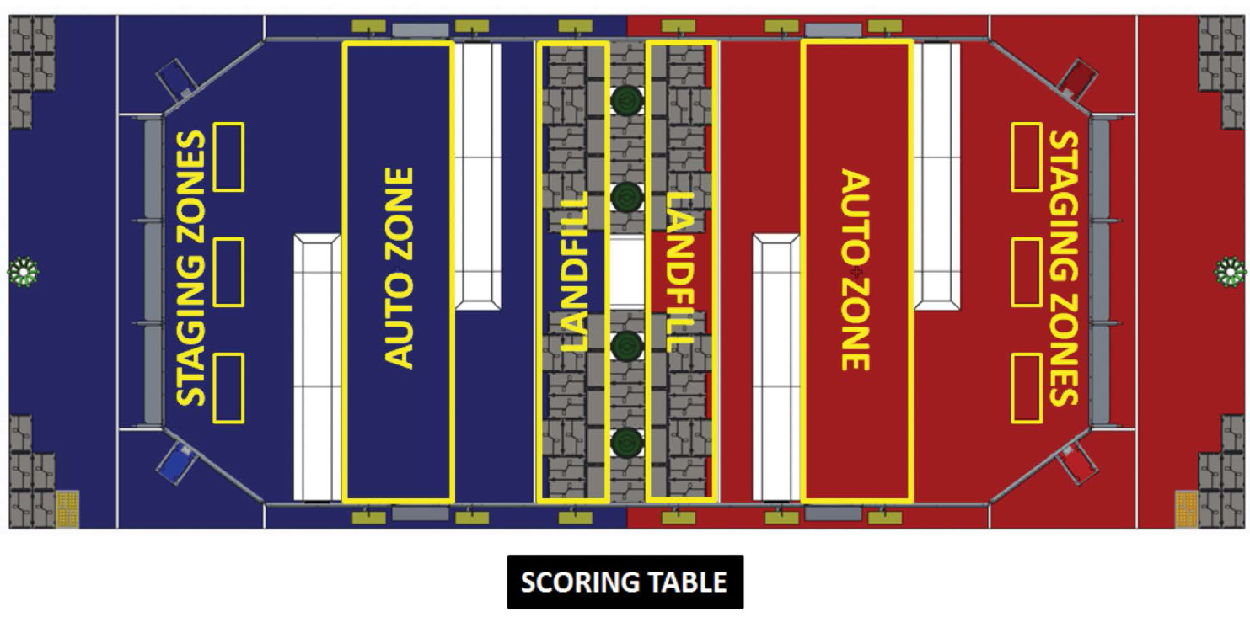
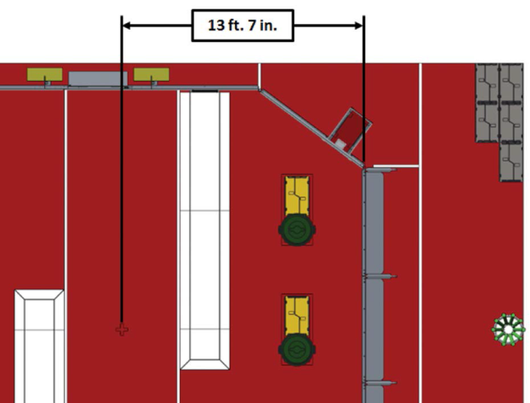
Zone Markings
Landmark Location:
Used in coordinating game play strategy only

Slide 19
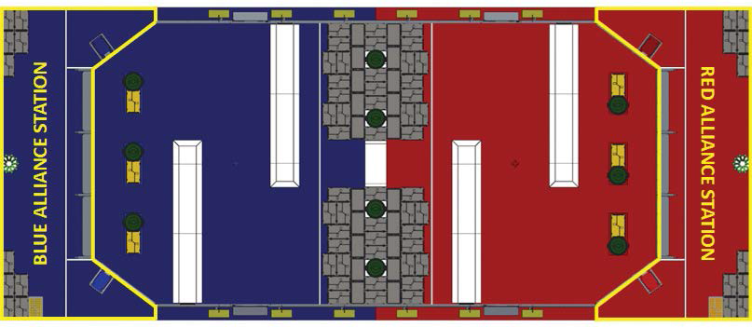
Alliance Stations
Bin containing Litter

Slide 20
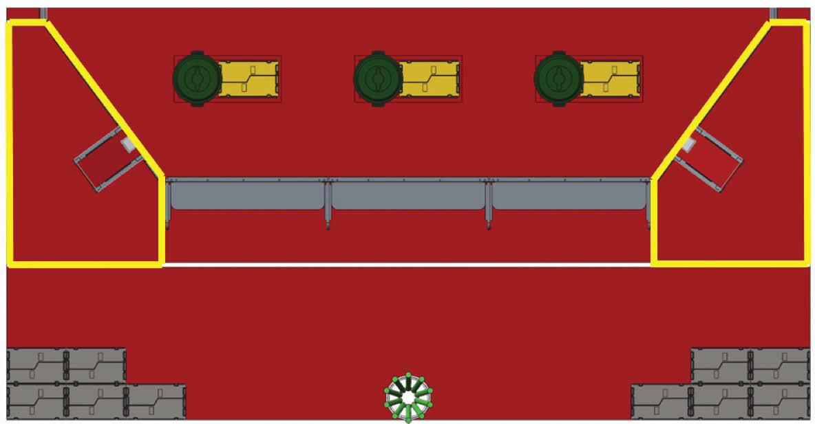
Human Player Zone

Slide 21
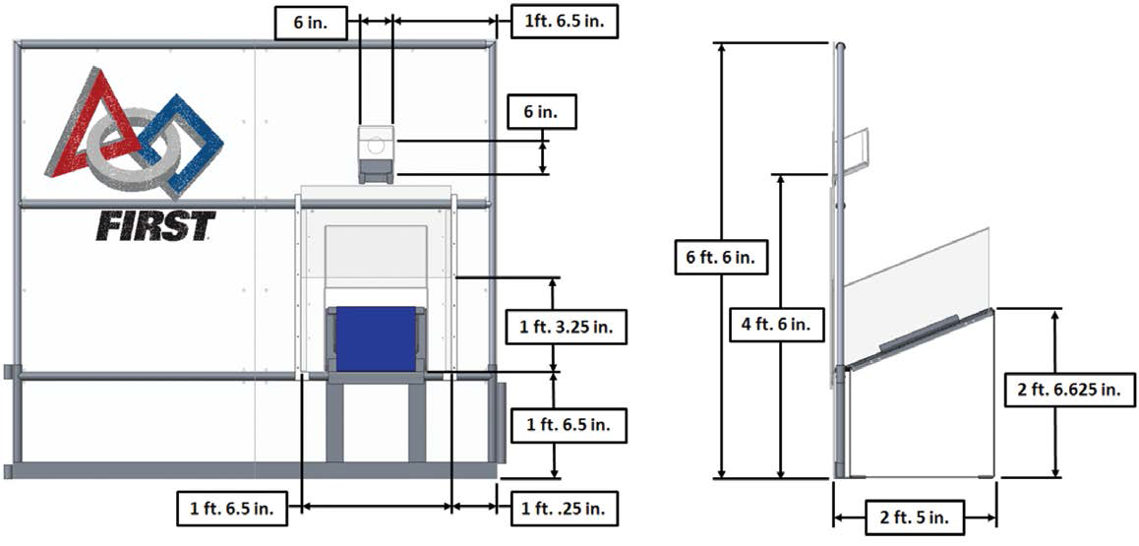
Human Player Station
Litter Chute
Tote Chute and Door

Slide 22
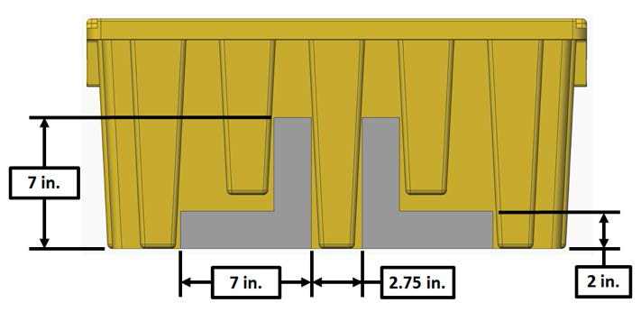
Vision Guides on Yellow Tote

Slide 23
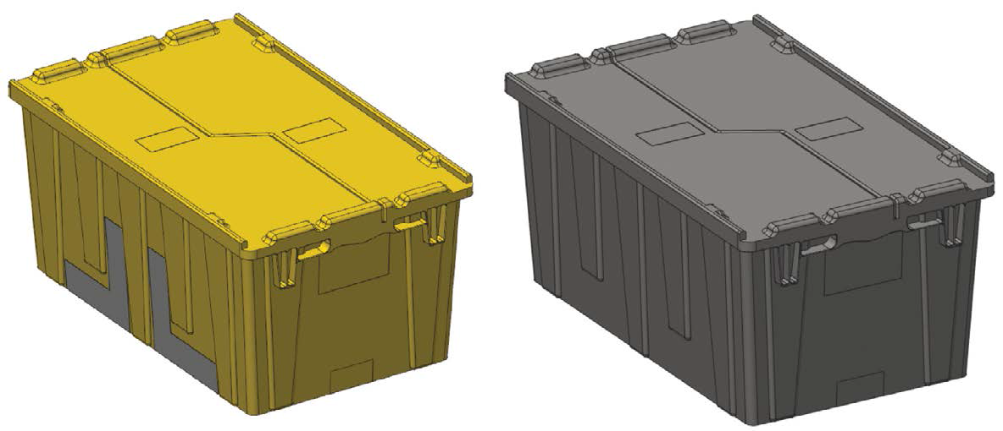
Game Elements - Totes
6 Yellow Totes
128 Gray Totes
Each Tote:
weighs approximately 7.8 lbs.
Secured closed with cable ties
26.9 in. long
16.9 in. wide
12.1 in. tall

Slide 24
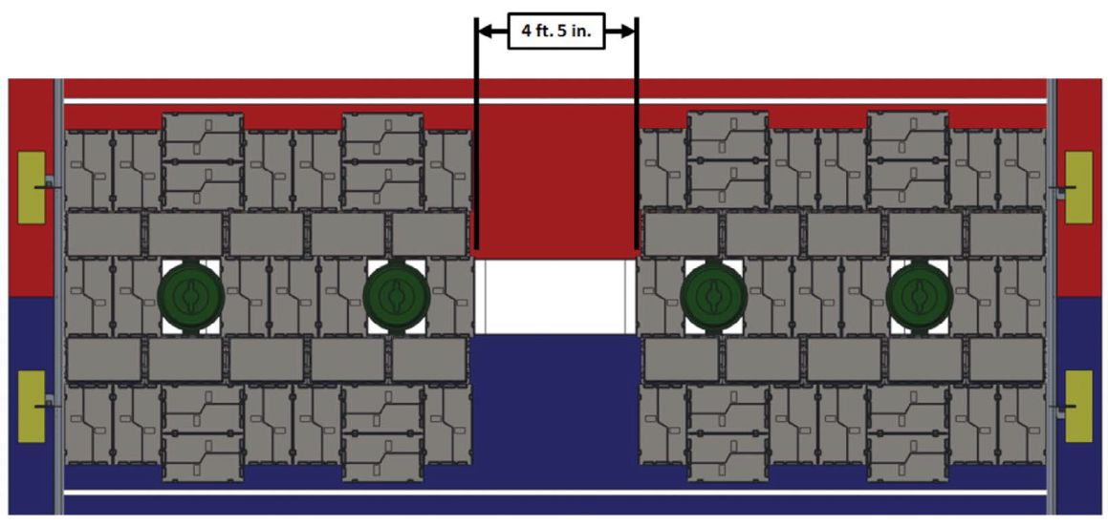
Game Elements - Totes
Gray Totes | Yellow Totes
12 placed on Step | 1 in each box in Staging Zone per alliance
28 placed in each Landfill Zone
30 place in each Alliance Station
Some Totes are
upside down
Different orientations
Stacked 3 high

Slide 25
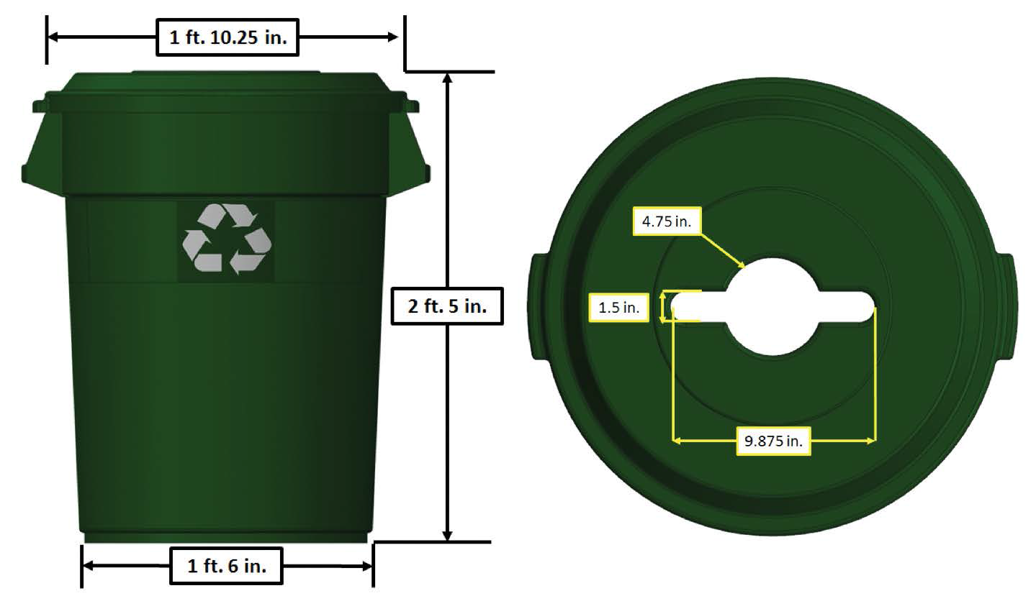
Game Elements - Recycling Containers
Each Container:
Lid secured with cable ties
weighs approximately 8.65 lbs.
21.9 in. diameter
28.8 in. tall (includes lid)

Slide 26
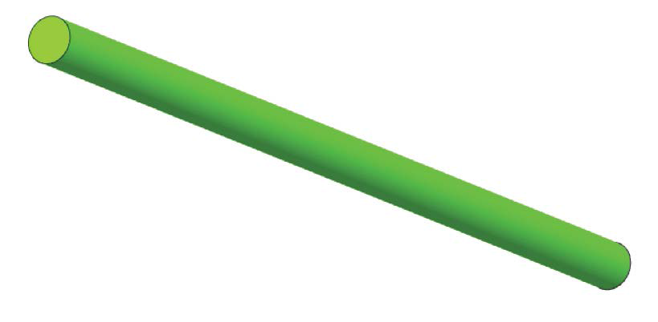
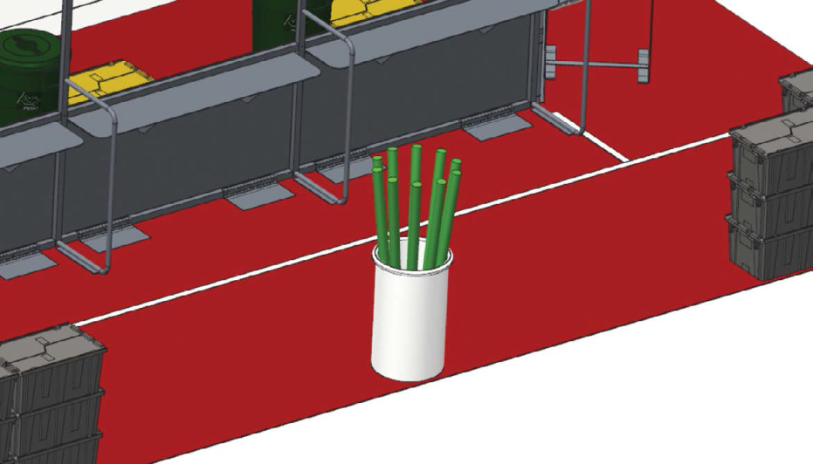
Game Elements - Litter
Each Litter:
Green Pool Noodle
4 ft. 10 in. long
2.6 in. outside diameter
Start with 10

Slide 27
The Game – Scoring
Note:
With the exception of unprocessed Litter, if the actions of one Alliance cause any of the other Alliance’s game elements that are in scoring position to no longer be in scoring position, the affected Alliance will be credited points for the displaced game elements at the conclusion of the Match.

Slide 28
The Game – Auto
Action | Value
Robot Set | 4
Tote Set | 6
Container Set | 8
Robot Set:
All robots on an Alliance move themselves to, and are fully contained by, their Auto Zone at the end of Auto
Tote Set:
All three Yellow Totes from an Alliance are fully contained by the Auto Zone, but do not meet the requirements of a Stacked Tote Set, at the end of Auto
Container Set:
Any of three recycling containers that are all fully contained in the Auto Zone at the end of Auto

Slide 29
The Game – Auto
Action | Value
Stacked Tote Set | 20
Stacked Tote Set:
All three yellow Totes arranged so that at the end of Auto:
Stacked one on top of another in a single column
Only the bottom most Tote is in contact with the Auto Zone
The entire structure is fully contained by the Auto Zone, and
The entire structure is free of contact from robots
Stacked Tote Set

Slide 30
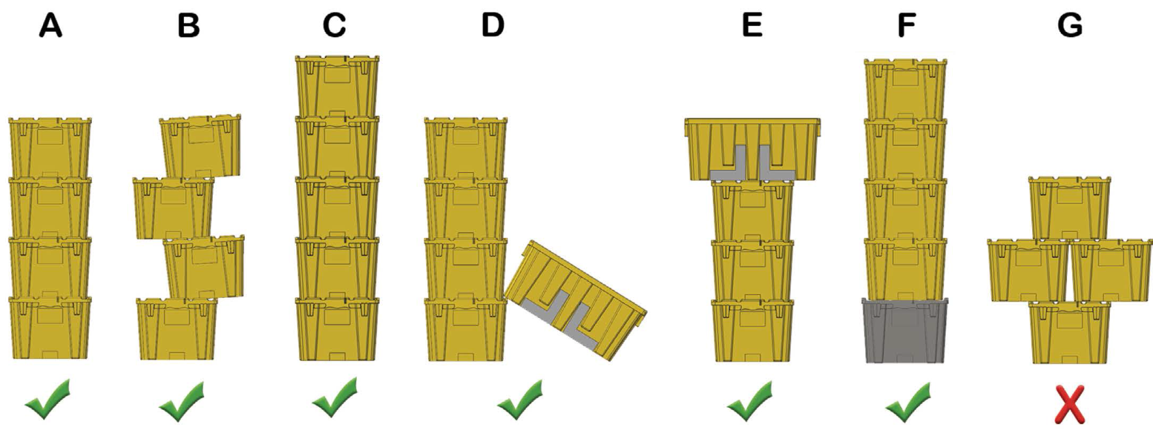
The Game – Coopertition
Action | Value
Coopertition Set (Qualification Only) | 20 for each Alliance
Coopertition Stack (Qualification Only) | 40 for each Alliance
Both Alliances are awarded points if four yellow Totes are on Step:
Set if four are fully supported by Step (could be on another Yellow Tote)
Stack (see below)
Note: Awarded when accomplished; Could change from a set to a stack during match but are not awarded both.

Slide 31
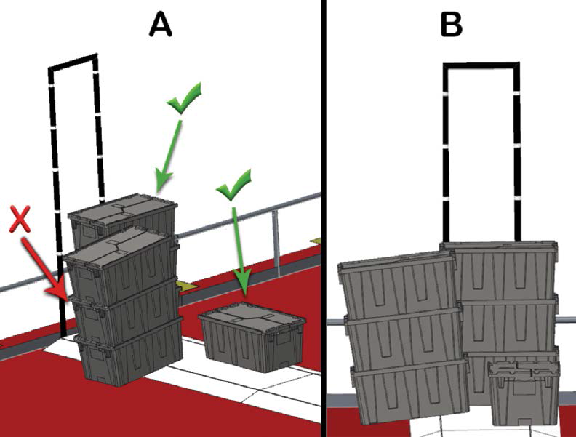
The Game – Teleop
Action | Value
Scored Gray Tote | 2 per tote
Gray Tote is scored if it is fully supported by a Scoring Platform and no portion of the Tote extends above the top of the Backstop

Slide 32
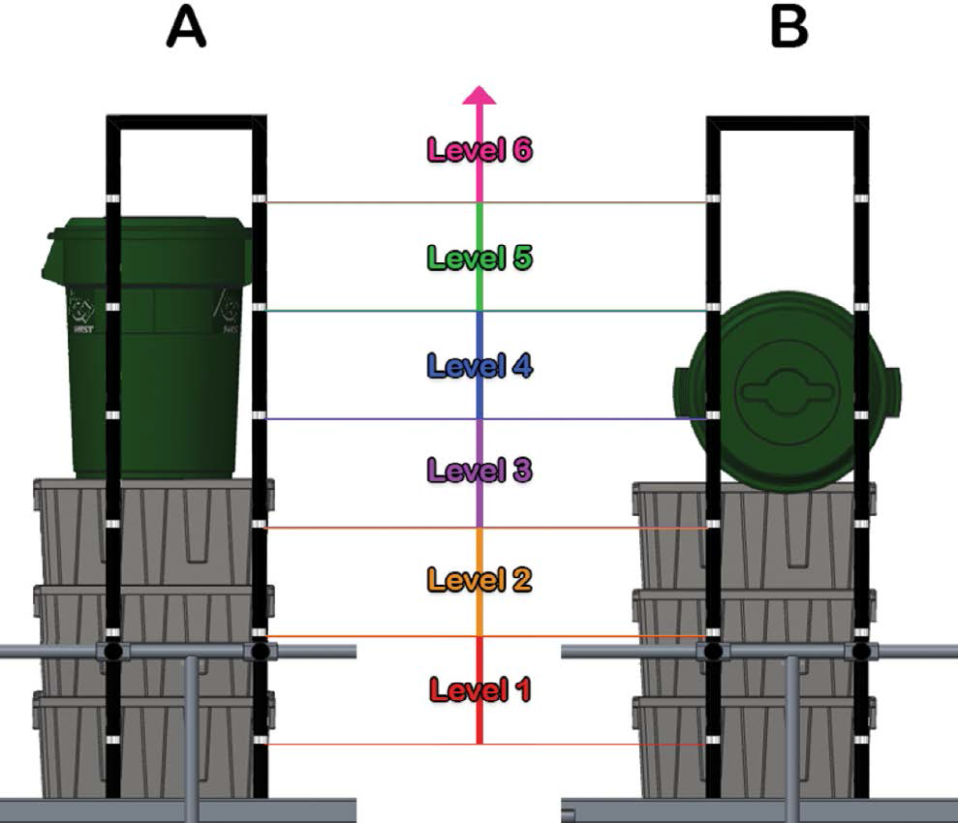
The Game – Teleop
Action | Value
Scored Recycling Container | 4 per level
Recycling Container is scored if it is fully supported by only scored Gray Totes. Points are awarded based on lowest Level in which a portion resides.

Slide 33
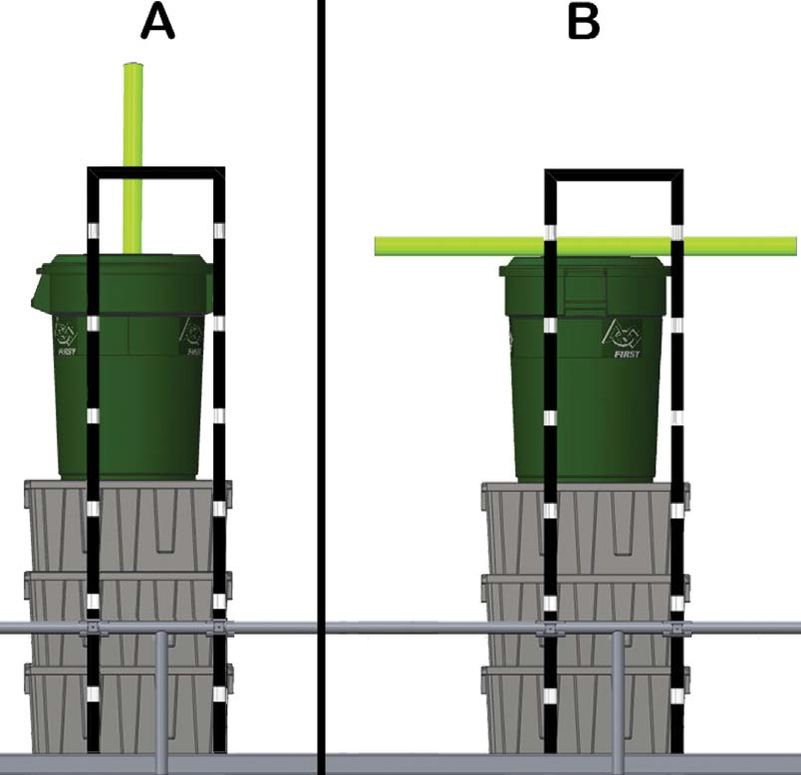
The Game – Teleop
Action | Value
Litter Scored in/on Recycling Container | 6 per Recycling Container
Litter in/on Recycling Container is scored in or on that Recycling Container. A maximum of one Litter will be scored per Recycling Container.

Slide 34
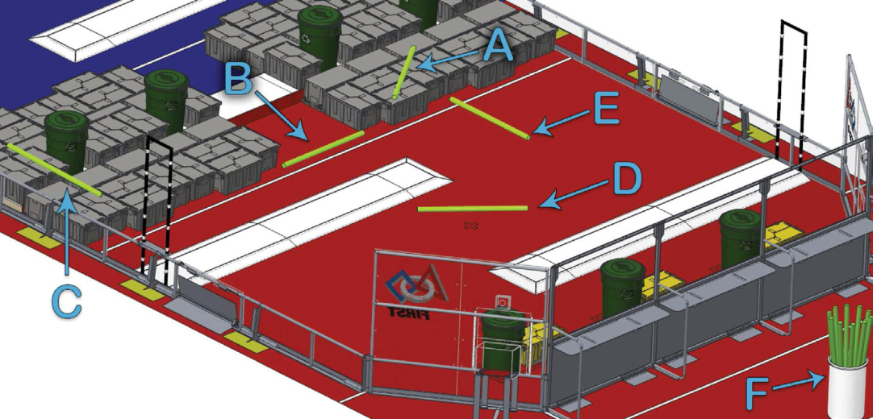
The Game – Teleop
Action | Value
Litter Scored in Landfill Zone | 1 per Litter
Landfill Zone
Litter Scored in Landfill Zone when it is fully contained within the zone on their side of the field.
In example to right, only A and B are in red Landfill Zone. C is in both red and blue so it does not count for either Alliance. D, E and F are not contained in Landfill Zone and do not score as Litter in Landfill Zone.

Slide 35
The Game – Teleop
Action | Value
Unprocessed Litter Bonus | 4 per Litter
Landfill Zone
Unprocessed Litter bonus is given to Alliance for each Litter that is fully contained by the opposite side of the Field and not scored in the Landfill Zone or scored in a Recycling Container.
In example to right, D and E are scored for the blue Alliance. Litter F remains in the Bin and does not score as an unprocessed Letter Bonus as it is not on the field.

Slide 36
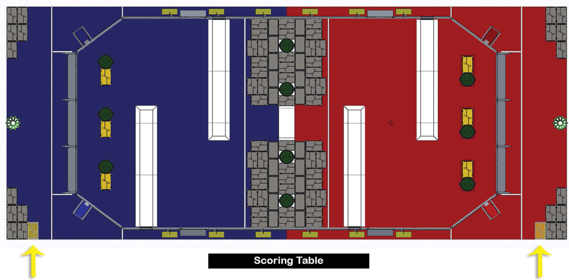
Match Logistics
A drive team may elect to remove the Yellow Tote from the Staging Zone directly in front of their Player Station and instead place it in the Alliance Station.
Game elements ejected from the Field will remain out of play for the remainder of the match.
Drive teams may not move, nor preload Totes, Recycling Containers, or Litter onto their robot prior to the start of the Match. There are no rules that prohibit a robot from being in contact with Totes or Recycling Containers at the start of the match.

Slide 37
The Game – Robot Positioning
When placed on the field for a match, each robot must be:
in compliance with all robot rules (i.e. have passed Inspection),
fully supported by the floor, Scoring Platform, and/or Scoring Platform ramps on their Alliance’s side of the field, and
Completely outside of their Auto Zone and Landfill Zone
Drive teams may only bring hand tools, including battery-operated hand tools, onto the field to configure or disassemble their robots.
Drive Teams may not cause significant or repeated delays to the start of the match.

Slide 38
Game Play – Match Timing
Match is 2 minutes and 30 seconds long
Autonomous period is 15 seconds at beginning
Teleoperated period is 2 minutes and 15 seconds long

Slide 39
Game Play – General Rules
The following actions are prohibited with regards to interaction with field elements (A-D exclude Totes, Recycling Containers, and Litter):
Grabbing
Grasping
Grappling
Attaching to
Becoming entangled
Hanging
Damaging
Tying
Robots may not push or react against the white horizontal surface of the Step. Incidental reaction while interacting with Totes or Recycling Containers is an exception to this rule.

Slide 40
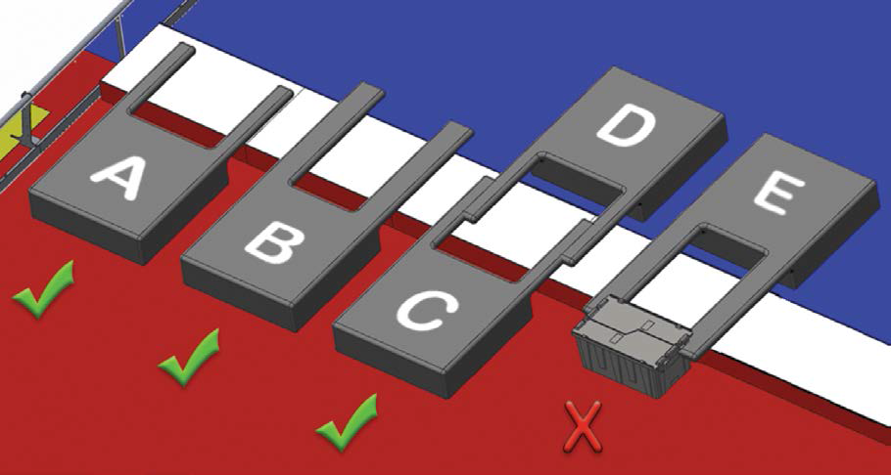
Game Play – General Rules
Robots may not contact anything beyond the Step. Momentary contact as a result of Robot interaction over the Step is an exception to this rule. If a Robot become inoperable or “stuck” while some portion of the Robot is extending beyond the Step, the Robot will not receive multiple Fouls.

Slide 41
Penalty Assignment
Upon a rule violation, a Foul will be issued and six points will be decremented from the offending Alliance’s score.
The minimum score for an Alliance in a match is zero.

Slide 42
Human Actions
Drive Team members must remain fully within the Alliance Station for the duration of the Match, unless for personal safety.
Coaches may not touch Totes or Litter, unless for personal safety.
Litter may be introduced onto the Field only during Teleop and only in the following ways:
Through the Litter Chute, or
Over the Alliance wall prior to the last twenty second of the match
Totes may only be introduced to the Field through the Tote Chute

Slide 43
Robot Size
Robot height must not exceed 6 ft. 6 in. during the Match.
The Robot must be able to be arranged into a transport configuration with dimensions which do not exceed (may be met with additional aids such as bungee cords, minor disassembly, etc.):
28 in. wide x 42 in. long x 78 in. tall.
Once on the field, no width or length configuration size restrictions.
Robot weight may not exceed 120 lbs. (includes all elements of all additional mechanisms and the optional bumpers but excludes battery and cable).

Slide 44
Robot
Robots may not cause Totes, Recycling Containers, and/or Litter to completely leave the Field.
Robots may not cause Totes, Recycling Containers, and/or Litter to completely transfer from their side of the Field, or from the Step, onto the opposite side of the Field.
Robots may not intentionally detach or leave parts on the field.

Slide 45
Robot
Team numbers must be displayed on the Robot and meet the following criteria:
Consist of numerals at least 3.5 in. high, at least 0.5 in. in stroke width, and be clack in color with white background extending at least 1 in. from the edges of the numbering,
Be positioned around the Robot such that an observer walking around the perimeter of the Robot can unambiguously tell the Team’s number from any point of view.

Slide 46
Considerations
Order | Points
1 | Qualification score
2 | Cumulative sum of Coopertition Points
3 | Cumulative sum of auto points
4 | Cumulative sum of scored Recycling Container points
5 | Cumulative sum of scored Tote points
6 | Cumulative sum of scored Litter points (Litter in a scored Recycling container + Litter scored in the Alliance’s landfill zone + Unprocessed Letter Bonus)
6 | Random sorting by FMS
What is important to do?
For auto period scoring
For teleop period scoring
For making it into the Playoff round
For tie breaking in ranking points
For durability and reliability
To win engineering awards
Based on importance:
Do you want a big or small robot?
What kind of drive system do we need (no defense this time)?

Slide 47
Scoring – What can we contribute?
Auto Point Values
Action | Value | Difficulty
Robot Set | 4 | Should be able to move robot to Auto Zone to contribute to Alliance possibility
Tote Set | 6 | Should be able to move tote to Auto Zone to contribute to Alliance possibility
Container Set | 8 | More difficult to do but need to be able to manipulate Recycle Container if we want to stack on Gray Tote
Stacked Tote Set | 20 | Very difficult for alliance to accomplish but might be easier for one team to stack all three. However, could contribute if we could position Tote for stacking or add at least one to stack.

Slide 48
Scoring – What can we contribute?
Teleop Point Values
Action | Value | Difficulty
Scored Gray Tote | 2 per tote | Should be able to push or place Tote
Scored Recycling Container | 4 per level | Need to be able to pick up Recycling Container and lift it high enough to place on Gray Tote Stack
Litter Scored in/on Recycling Container | 6 per Recycling Container | Difficult to balance on Container but should think about putting Litter into Container before trying to score it
Litter Scored in Landfill Zone | 1 per Litter | Should be able to push or pick up Litter to get points and reduce unprocessed Litter bonus
Unprocessed Litter Bonus | 4 per Litter | Requires good human player throwing capabilities
Coopertition Set (Qualification Only) | 20 for each Alliance | Requires placing yellow Tote on Step and moving Gray Totes out of the way without causing penalties
Coopertition Stack (Qualification Only) | 40 for each Alliance | Requires cooperation from competitors but worth lots of points. Worthless in Playoff rounds.

Slide 49
Considerations
What can be done so that the robots will be done in time to practice (five weeks)?
Should we plan to use the camera?
What are strategies for manipulating game piece elements
Think about how you would do it if only humans played
What is impact of limited size restrictions?

Slide 50
Considerations
What worked well in the past that we should repeat?
What didn’t work well in the past that we should avoid?
What can be programmed?
For building three robots?
What do we know how to do?
What can be done effectively?

Slide 51
Considerations
Based on scoring and tie breaking, what are two or three key strategies:
Ability to maximize elimination round points
Autonomous programming for mobility or scoring
Ability to collaborate with Alliance partners
Take enough time to know what we want to do before we decide how to do it.

Slide 52
Key Dates
Robot Bag and Tag date is:
February 17, 2015

